Slide 1
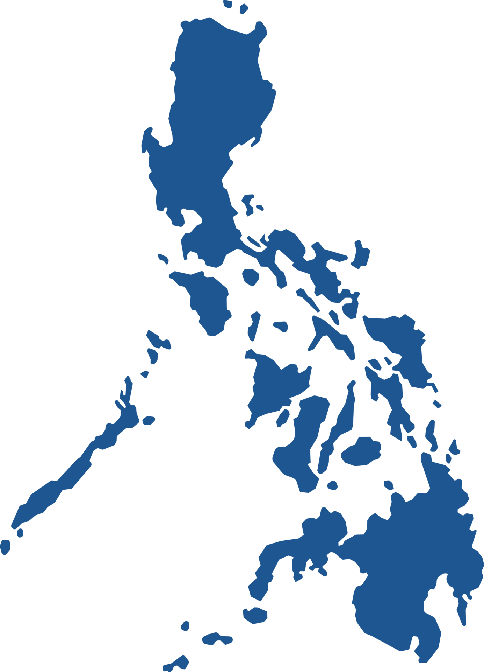
ABOUT THE
Philippines
Final Project | Emma Weeks

Slide 2
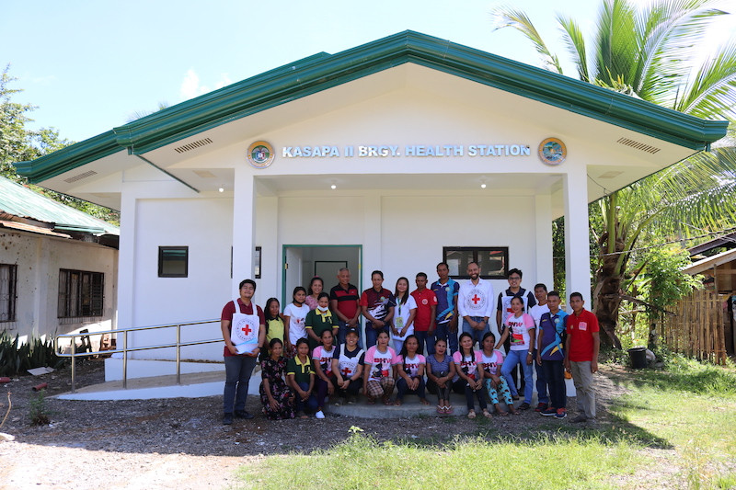
The Philippine Public Health System
In 2019, President Rodrigo Duterte signed the Universal Health Care Bill into law (Cordero, 2022).
  This created large reforms in healthcare.
The Philippines was one of the first countries to introduce the pneumococcal conjugate vaccine, the Haemophilus influenzae vaccine, and the rotavirus vaccine (“Infectious disease crisis in the Philippines,” 2019).
The Philippines reduced child mortality by more than 60% in 25 years, achieving a Millennium Development goal as a result of child vaccinations.

Slide 3
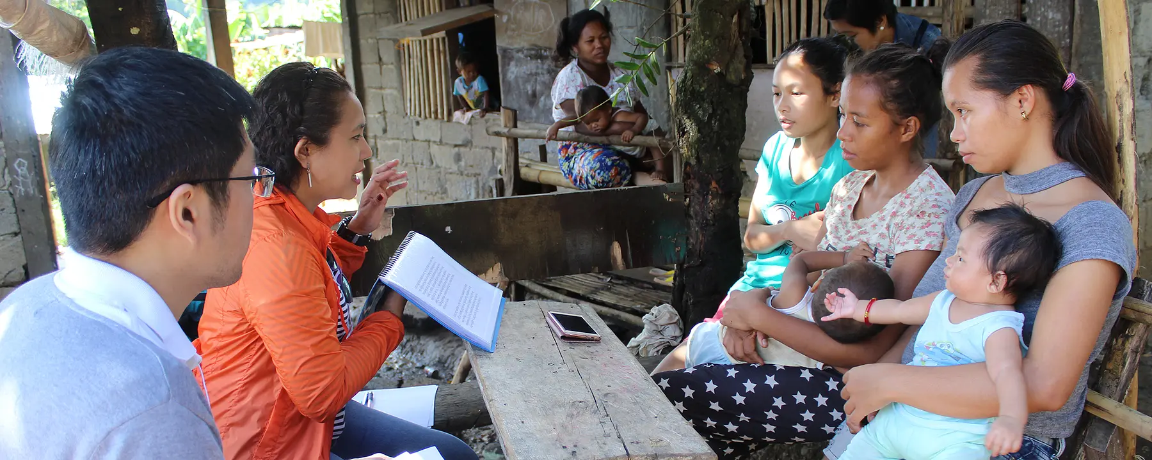
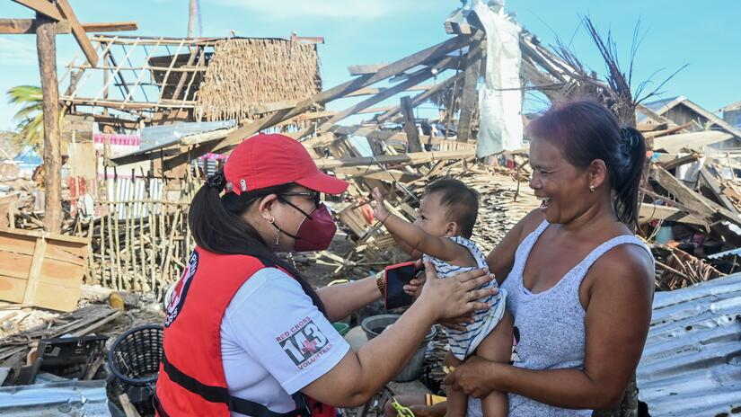
Factors that Contribute to Health Status
Challenges for Quality, Accessible, Equitable Healthcare in the Philippines
Global health crises
Natural disaster - earthquakes, tsunamis, typhoons
Gender inequality
Climate change
Water and sanitation
Housing crisis
Employment
Food production
Hospital and medical equipment shortages
(United States Agency International Development, n.d.)
Notes:
https://www.usaid.gov/philippines/health

Slide 4
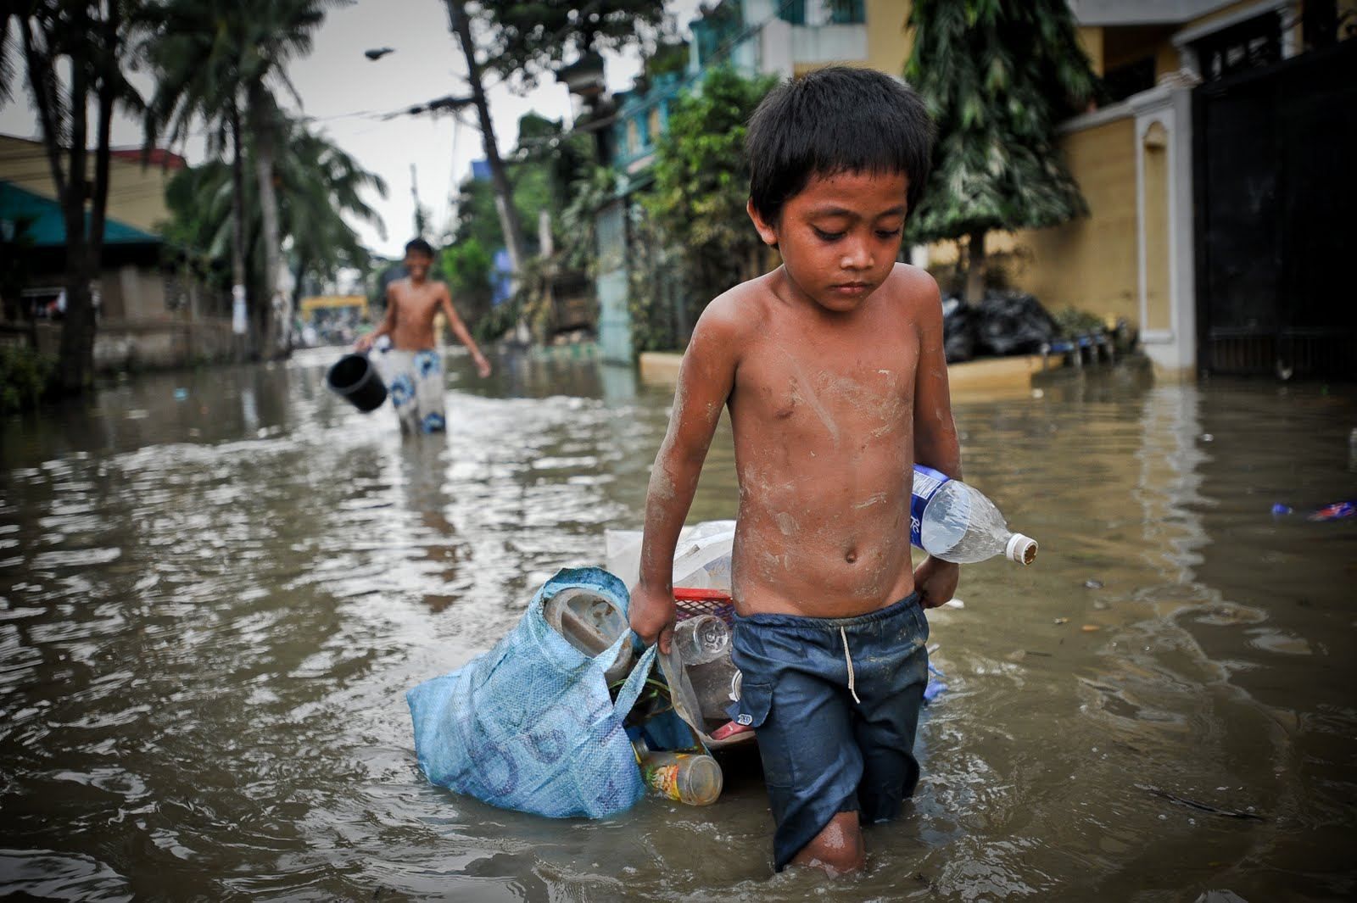
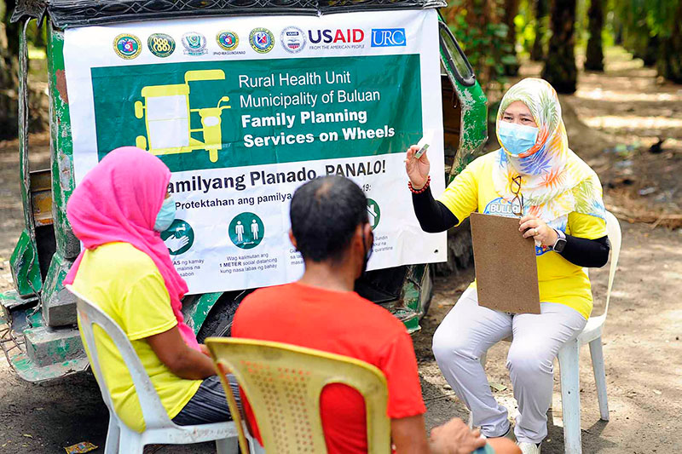
Factors that Contribute to Health Status
Education
High prevalence of infectious disease
High teenage pregnancy rates
High rates of preventable maternal and newborn deaths
Out-of-pocket expenses for healthcare
Lack of family planning resources
Distance to health facilities
Income
Misuse of funding
(United States Agency International Development, n.d.)
Notes:
https://avantehs.com/i/philippines/articles/improving-healthcare#:~:text=The%20shortage%20of%20hospitals%20and,facilities%20with%20broken%20medical%20devices.

Slide 5
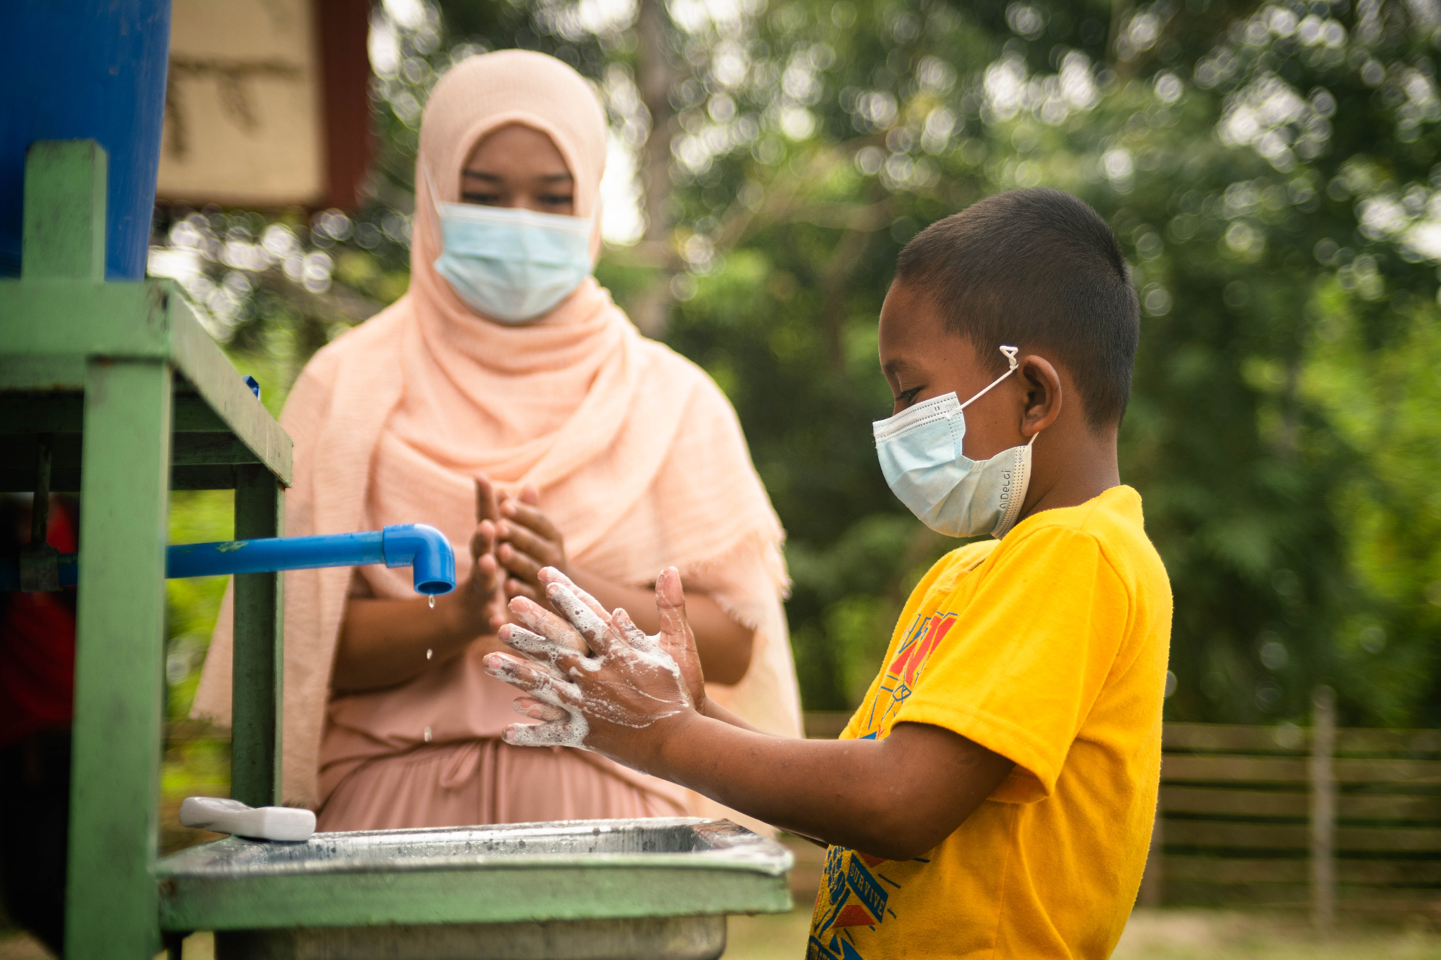
SDG 3:
Good Health & Wellbeing

Slide 6
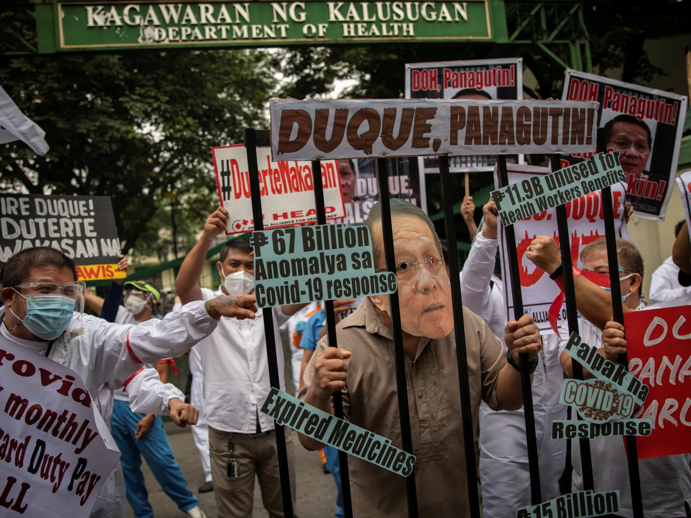
Key Threats to Achieving SDG 3
Lack of Organization in the Philippine Public Health Sector
The Universal Health Care Bill aimed to increase primary care (Cordero, 2022).
  However, a lack of oversight and accountability among leaders has prevents the change that this bill oversees.
  This has also contributed to the uneven and slow distribution of vaccines around the country.
In 2022, the Philippines had a 5.024 trillion Philippine peso (PHP) budget for 2022.
  This budget is highly mismanaged, and citizens are unable to afford the costly services overseen by this budget (Cordero, 2022).
SDG Target 3.8 Universal Healthcare
SDG Target 3.d Improve Primary Care
Notes:
Many citizens would rather first byu a meal for their families than pay for health services
Although vaccines have become significantly more available to the country, efforts to distribute them have fallen short

Slide 7
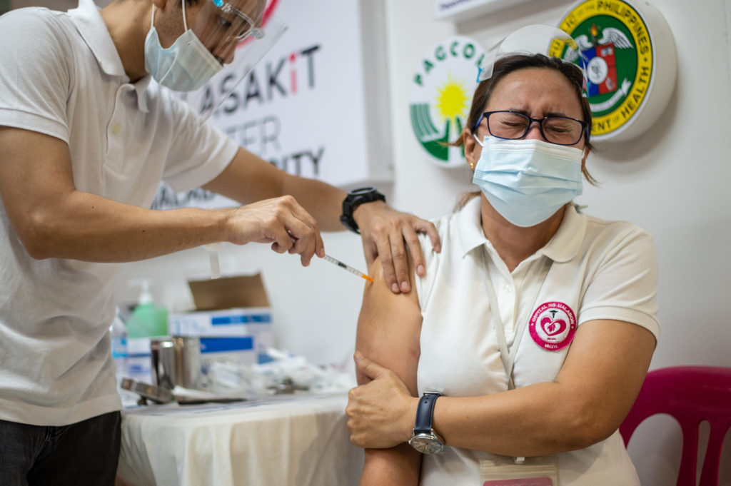
Key Threats to Achieving SDG 3
Infectious Diseases Crisis / Mistrust in Vaccines
Most prevalent diseases are dengue, diphtheria, measles and polio (“Infectious disease crisis in the Philippines,” 2019).
  Dengue was declared an epidemic in 2019
When Dengvaxia, the only available dengue vaccine was introduced to the Philippines, 14 children out of the 800,000 vaccinated died with no direct link to the vaccine.
  The Philippines decided to suspend the Dengvaxia vaccination, which resulted in a reduced confidence in citizens regarding the safety of immunization by vaccines in general (“Infectious disease crisis in the Philippines,” 2019).
SDG Target 3.2 Reduce Child Mortality
SDG Target 3.3 Reduce Communicable Disease
Notes:
In the past, the Philippines has had very effective measures to implement vaccines to reduce the spread of communicable diseases
However, the positive results of years of immunization campaigns have been reversed, and vaccine-preventable diseases are once again rampant in the country

Slide 8
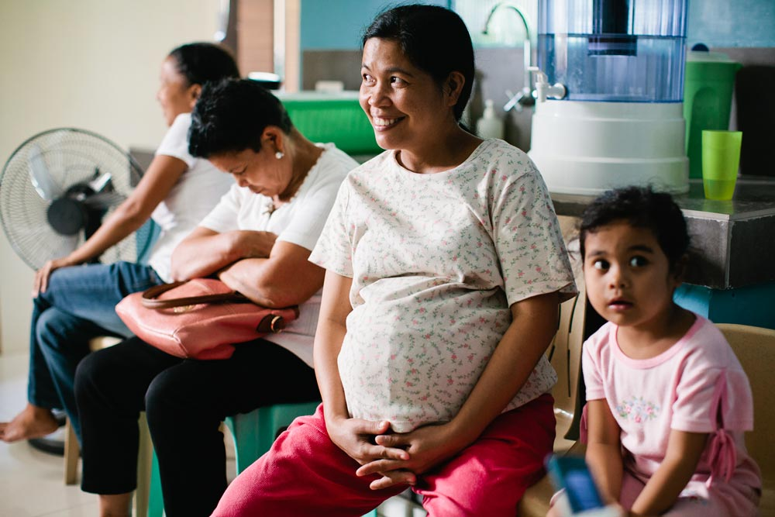
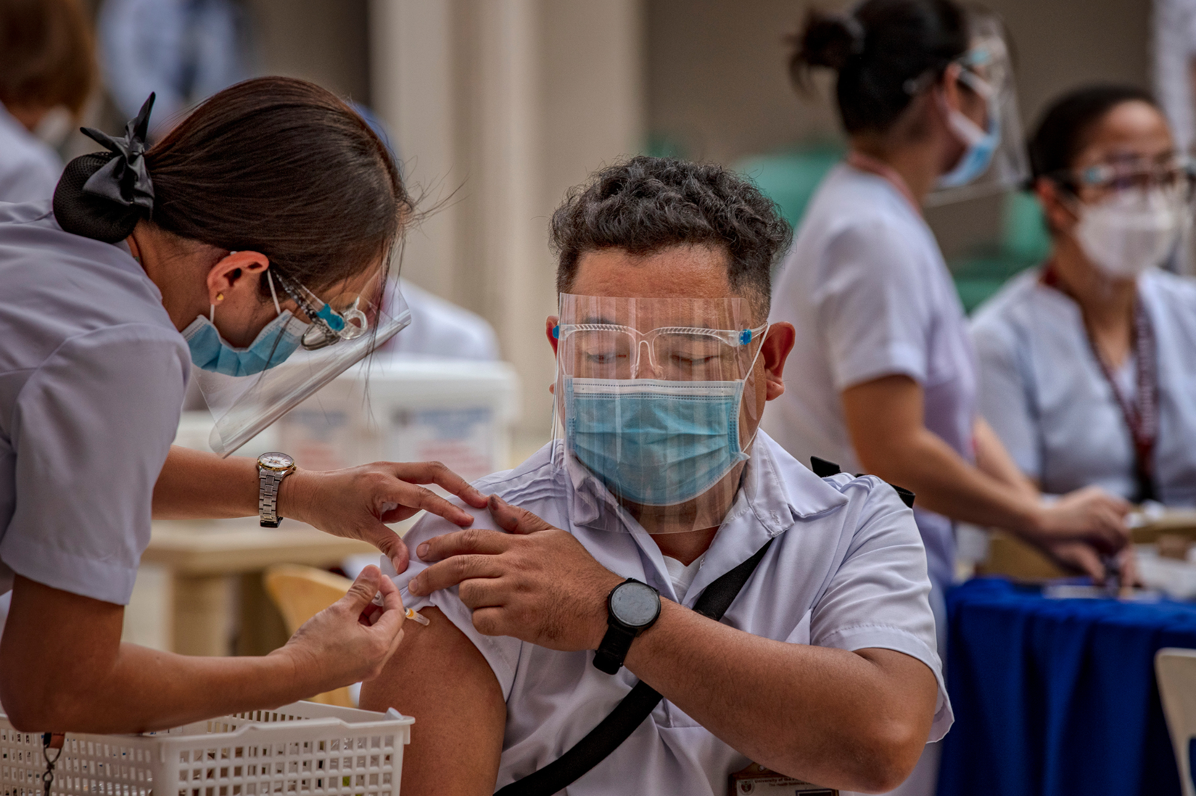
Recommendations
Collaboration between the government and the public is crucial to improve the health of the country (Cordero, 2022).
  Without this collaboration, negative health outcomes are more prevalent.
  An example is given of the lack of herd immunity 2 years after the first case of COVID. Overall, the Philippines needs to create a better system to manage health funds and a secure plan to ensure equitable, high-quality, universal access to healthcare.
It is crucial for the government to rebuild the trust of the population in order to combat diseases (Infectious disease crisis in the Philippines,” 2019).
  Investing in public health and information campaigns is encouraged to promote the use of vaccines to prevent child deaths.
Notes:
In the past, the Philippines has had very effective measures to implement vaccines to reduce the spread of communicable diseases
However, the positive results of years of immunization campaigns have been reversed, and vaccine-preventable diseases are once again rampant in the country

Slide 9
Improving Health Globally
Improving access, quality, and affordability of primary care in the Philippines and other low and low-middle income countries can create better health outcomes around the world.
Preventing illness through vaccinations and screenings.
Early detection and management of chronic diseases.
Establishing ongoing care relationships for better health management.
Reducing health disparities among different social groups.
Saving costs by addressing health issues early.
Empowering communities with health education.
Strengthening overall healthcare systems and spreading access to rural areas.
Reducing high costs of treatment for preventable diseases.
(Langlois et al., 2020)

Slide 10
Resources
Cordero, D. A. (2022). An evaluation of the Philippine healthcare system: Preparing for a robust public health in the future. Journal of Preventive Medicine & Public Health, 55(3), 310-311. https://doi.org/10.3961/jpmph.22.154
Ensure healthy lives and promote well-being for all at all ages. (n.d.). United Nations. April 18, 2024, from https://sdgs.un.org/goals/goal3#targets_and_indicators
Infectious diseases crisis in the Philippines. (2019). The Lancet Infectious Disease, 19(12). https://doi.org/10.1016/S1473-3099(19)30642-5
Langlois, E. T., McKenzie, A., Schneider, H. & Mecaskey, J. W. (2020). Measures to strengthen primary health-care systems in low- and middle-income countries. Bull World Health Organization. 98(11), 781-791. https://doi.org/10.2471/BLT.20.252742
United States Agency International Development. (n.d.). Health. https://www.usaid.gov/philippines/health

